Slide 1
Text Mining & NLP
Terminology, Process & Word2Vec
Jeremy Bergmann - Omaha Data Science Academy

Slide 2
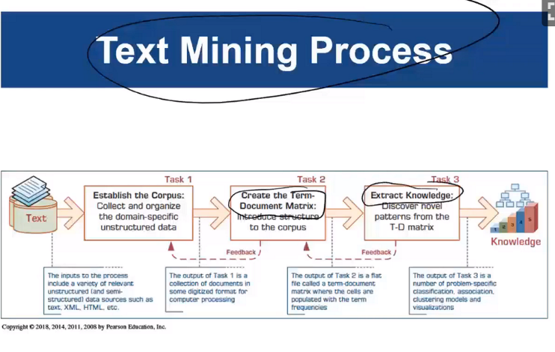
Text Mining Definition
Text Mining - Similar to Data Mining, which is the “non-trivial process of identifying valid, novel useful and understandable patterns” in unstructured, text-based data sources.
Notes:
Unstructured data - information that either does not have a pre-defined data model or is not organized in a pre-defined manner. Unstructured information is typically text-heavy, but may contain data such as dates, numbers, and facts as well. (80-90% of firm’s data)

Slide 3
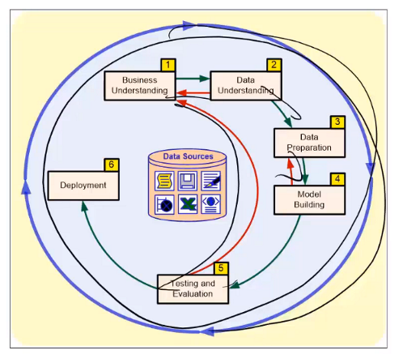
Data/Text Mining Process: CRISP-DM
Notes:
Only difference exists in the data sources that are used: Quantative vs. Textual

Slide 4
Need for Text Mining
80 -95 % of all corporate data is in unstructured formats
Unstructured corporate data is doubling in size every 18 months
Tapping into unstructured sources gives competitive insights & advantages. Examples include:
Social media trends for various products
Understanding drivers of customer satisfaction
E-mail alerting & spam filtering
ML automation - text-based, manual documentation

Slide 5
Data Mining Terminology
Corpus & Corpora (Scope Texts)
Terms & Concepts (Words & Themes)
Bag of Words (Synonyms & Homonyms)
Stemming (Root form/meaning)
Stop/Include words (Parts-of-Speech, Specific phrases)
Word Frequency
Term-by-document matrix (Quantitative Transform)
Knowledge Extraction (Classification, Clustering, Trend Analysis)
Notes:
Transformation Process - Top-to-bottom

Slide 6
NLP Definition
Natural language processing (NLP) is a subfield of computer science, information engineering, and artificial intelligence concerned with the interactions between computers and human (natural) languages, in particular how to program computers to process and analyze large amounts of natural language data.
Additionally, NLP is a subfield of artificial intelligence and computational liguistics, that uses ML algorithms to provide context to natural language data, via the creation of word embedding techniques.
Notes:
Challenges in NLP: speech recognition, natural language understanding, and natural language generation.

Slide 7
NLP vs. Text Mining
Text mining techniques are usually shallow and do not consider the text structure.Usually, text mining will use bag of words, n-grams and possibly stemming over that.
In NLP methods usually involve the test structure. You can find there sentence splitting, part of speech tagging and parse tree construction.
Typical text mining method will consider the following sentences to indicate happiness (due to word associations) while typical NLP methods detects that they are not (latent meanings).
I am not happy
I will be happy when it will rain
If it will rain, I'll be happy.
She asked whether I am happy
Are you happy?
Notes:
Key difference is in goal - grouping/classification (text mining) vs. meaning & context (NLP)
NLP Introduction: https://blog.algorithmia.com/introduction-natural-language-processing-nlp/

Slide 8

NLP “In Action” - IBM Watson vs. Jeopardy
Notes:
Key difference is in goal - grouping/classification (text mining) vs. meaning & context (NLP)

Slide 9
NLP Challenges
“Dream of AI community”
Natural Language is vague, context-driven
Extensive knowledge and training on a topic needed for true “understanding”
Challenges in NLP processing:
part-of-speech tagging (noun/verb/adj)
word sense disambiguation (multiple meanings)
imperfect input (errors, lol-speak)
Speech acts
AI/ML algorithms that are capable of automatically reading and obtaining knowledge from text

Slide 10
Word2Vec
Word2vec is a group of related models that are used to produce word embeddings, which are the set of language modeling and feature learning techniques in natural language processing (NLP) where words or phrases from the vocabulary are mapped to vectors of real numbers
These ML models are trained to reconstruct linguistic contexts of words.
Word2vec takes as its input a large corpus of text and produces a vector space, typically of several hundred dimensions, with each unique word in the corpus being assigned a corresponding vector in the space.
Word vectors are positioned in the vector space such that words that share common contexts in the corpus are located in close proximity to one another in the space.
Given enough data, usage and contexts, Word2vec can make highly accurate guesses about a word’s meaning and sentiment based on past appearances!
Notes:
Other word2vec overview links: https://skymind.ai/wiki/word2vec,
Skipgram algorithm: http://mccormickml.com/2016/04/19/word2vec-tutorial-the-skip-gram-model/

Slide 11
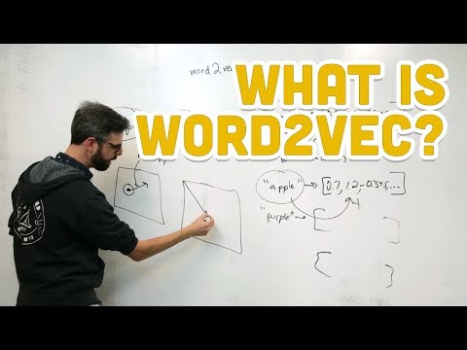
Word2Vec - 10-Minute Overview

